Slide 1

Diagosis of dental caries from x-ray images using Convolutional Neural Network
Doctor of Philosophy
STUDENT’S NAME: Fayqa mannan
SUPERVISOR’S NAME: Dr.Kashif Hanif
Session: 2018-2020
Department: CS
2019

Slide 2


Fayqa
fayqabio@gmail.com

Slide 3
TABLE OF CONTENTS
Introduction
Problem Background
Problem Statement
Motivation
Research Questions
Research Objectives
Aim and Scope of Research
Literature review
Methodology
Experimental / Simulation Setup
Future work
Fayqa
fayqabio@gmail.COM

Slide 4

1. INTRODUCTION
Fayqa
fayqabio@gmail.com

Slide 5
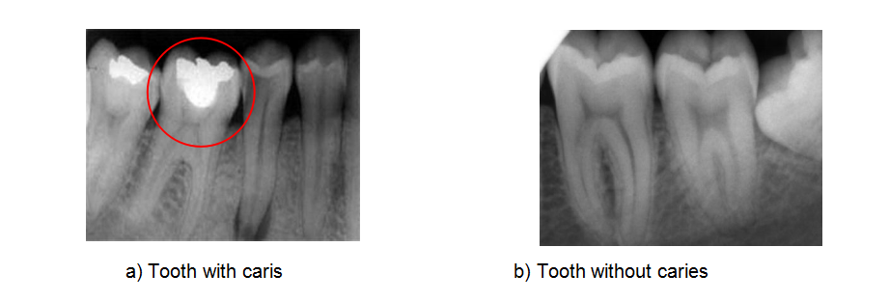
INTRODUCTION
What are dental caries ?
Why x-rays images?
Fayqa
fayqabio@gmail.com
1 of 15
Notes:
What are dental caries ?
Damage of tooth due to bacterial attack (acid production by bacterias)
Acid dissolve the hard tissues of teeth ie: enamel, dentin and cementum
Major types: occlusal caries(on the top of teeth),,,,,,interproximal caries (between two teeth)
Stages: Incipient (Early) , Moderate , Advance ,Severe
Why x-rays images?
easily detection of interproximal caries (between two teeth)
Type of X-rays: Major: Extraoral and intraoral
Bite-wing X-rays (upper and lower teeth of same area in mouth////bone density)
Periapical X-rays (only upper or lower tooth, show from crown to root////jaw diagnosis)
Occlusal X-rays (full arch of teeth either upper or lower)

Slide 6
INTRODUCTION
Domain: Machine learning
Sub-Domain: Deep Learning Using CNN models for detection of medical images
What is CNN ?
Used in areas of analyzing visual imagery (image recognition)
Layers: input , hidden, output layers
Hidden Layers: (convoloutional and pooling layers)
Fayqa
fayqabio@gmail.com
1 of 15
Notes:
Machine Learning:
a statical tool which used to ananlyse and explore the data......a ways to train the machines to learn from the previous data.
Types: Supervised(labled data, create a model and train the data) ,,,,,,,Unsupervised(data catagorized due to similarities, non labeling data),,,Reinforest
Machine Learning Algorithms: KNN, SVM, Decision tree, Logistic Regression , Random forest Naive byse
Deep learning: Sub-set of ML ,,,inspired from the function of human nervous system (neural network)
Main Types: ANN (artificial neural network) , RNN (recurrent neural network) , CNN (Convolutional neural network)
What is CNN ?
CNNs are used in areas of image and pattern recognition, speech recognition, natural language processing, and video analysis. to analyzing visual imagery,NLP and other cognitive tasks.
Structure:
Consists of 3 sets of layers input , hidden (convoloutional and pooling layers), output layers
Layers:
convolution layers: play the role of feature extractor.
pooling layers: reduse the size of representation(images),,,,most common approach is max pooling

Slide 7
2. PROBLEM BACKGROUND
Fayqa
fayqabio@gmail.com

Slide 8
PROBLEM BACKGROUND
Issues from last few years in CNN for detection of dental caries:
SR # | Year | Reference | Data-Set | Methodology | Accuracy | Issues
1 | 2017 | Detobal et al. | 400 | CNN (Alex Net) | 51% | Manually ROI (region of interest)
2 | 2017 | Oktay et al. | 100 | CNN (Alex Net) | 90% | Small Data Set
3 | 2017 | Sarivastava et al. | 3000+ | CNN (FCNN) | 61% | Few layers.
Fayqa
fayqabio@gmail.com
2 of 15
Notes:
Write your notes here.
Write here what you will speak during the presentation

Slide 9
PROBLEM BACKGROUND
Issues from last few years in CNN for detection of dental caries:
SR # | Year | Reference | Data-Set | Methodology | Accuracy | Issues
4 | 2018 | Yang et al. | 196 | Automatic methods fed on CNN | 74% | Samll dataset
5 | 2018 | Lee et al. | 3000 | CNN (Google lenet) | 82% | Cropped, downsize images
6 | 2018 | Lee et al. | 1740 | CNN (FCNN) | 81.0% premolar 76.7% molar | Cropped, downsize images
Fayqa
fayqabio@gmail.com
2 of 15
Notes:
Write your notes here.
Write here what you will speak during the presentation

Slide 10
PROBLEM BACKGROUND
Issues from last few years in CNN for detection of dental caries:
SR # | Year | Reference | Data-Set | Methodology | Accuracy | Issues
7 | 2019 | Datta et al. | Limited size | Customize clustering | 74% | Fail with low resolution x-ray image
8 | 2019 | Caselengo et al. | 185 trained dataset | CNN for semantic segmentation | 83% | Samll dataset
9 | 2019 | Moutselos et al . | 88 | Mask R-CNN | 83% | Manually classification
Fayqa
fayqabio@gmail.com
2 of 15
Notes:
Write your notes here.
Write here what you will speak during the presentation

Slide 11
PROBLEM BACKGROUND
Contribution :
CNN Model:
using CNN models for caries detection(proximal) through X-rays images
Accuracy :
Improve accuracy as comapred to previous research.
Fayqa
fayqabio@gmail.com
2 of 15
Notes:
1- CNN algorithms (VGG 16, VGG19, Google lenet) etc are used to detect the dental caries from x-ray images.
2- also try to improve accuracy.

Slide 12
3. PROBLEM STATEMENT
Fayqa
fayqabio@gmail.com

Slide 13
PROBLEM STATEMENT
Issue based on existing litrature:
small data set
croped,downsize images
menually ROI (region of interest)
Few layers
Low accuracy
Early detction of caries of caries usually not noticed
Fayqa
fayqabio@gmail.com
3 of 15
Notes:
Early detction of caries of caries usually not noticed
not widely working on X-rays images
small data set
menually ROI
Few layers
Low accuracy

Slide 14
4. MOTIVATION
Fayqa
fayqabio@gmail.com

Slide 15
MOTIVATION
Reasons to select certain problem among multiple problems:
Interest based :
Most common oral disease :
Early stage caries :
Other infections:
Costly treatments:
Need ecnomical way :
Fayqa
fayqabio@gmail.com
4 of 15
Notes:
Interest based : Interest based topic.
Most common oral disease : in children in Pakistan.
Early stage caries : usually not noticble.
Other inftions: Leads to other issues.
Costly treatments: Treatment of moderate and advance caries are very costly.
Need ecnomical way : to detect caries at early stage
CNN: a big concern in detecting disease through images.

Slide 16
5. RESEARCH QUESTIONS
Fayqa
fayqabio@gmail.com

Slide 17
RESEARCH QUESTIONS
How to diagosis of dental caries using Convolutional Neural Network ?
Fayqa
fayqabio@gmail.com
5 of 15
Notes:
How to diagosis of dental caries using Convolutional Neural Network ?

Slide 18
6. RESEARCH OBJECTIVES
Fayqa
fayqabio@gmail.com

Slide 19
RESEARCH OBJECTIVES
Detect the caries at early stages
Try to achived high accuracy
Fayqa
fayqabio@gmail.com
6 of 15
Notes:
CNN is the fastest emerging area with feilds for the diagnosis of diseases at early stages in an efficient and accurate way.
main aim of this study is to detect the caries at early stages to prevent any further problems.
Model for detecting dental caries at early stage which achived high accuracy.

Slide 20
7. AIM & SCOPE OF RESEARCH
Fayqa
fayqabio@gmail.com

Slide 21
AIM & SCOPE OF RESEARCH
AIM:
Treatment for modertae and advance caries are very costly.
Need some ecnomical way to detect caries at early stage i.e algorithmic detection
Scope:
Detection through Human teeth
x-ray images
Using published data
Fayqa
fayqabio@gmail.com
7 of 15
Notes:
AIM:
Treatment for modertae and advance caries are very costly.
Need some ecnomical way to detect caries at early stage i.e algorithmic detection
Scope:
Detection through Human teeth
x-ray images
Using published data

Slide 22
8. LITERATURE REVIEW
Fayqa
fayqabio@gmail.com

Slide 23
LITERATURE REVIEW
Related work in field of caries detection:
Sr # | References | Data-Set Source | Data-Set size | Methodology | Accuracy | Merits | Demarits
1 | Miki et al,2017 | Self generated | 52 | CNN(Alexnet) | 77.4% | CNN algo | Small Dataset
2 | Oktay , 2017 | Self generated | 100 | CNN(Alexnet) | 90% | CNN algo | Small Dataset
3 | Yauney et al, 2017 | Self generated | 27 | CNN (Truncated VGG) | 84.67%, | CNN algo | Small dataset
4 | Miki et al,2017 | Self generated | 52 | CNN (DCNN) | 88.8 % | CNN algo | Small dataset
5 | Prajapati et al, 2017 | Self generated | 251 | CNN(VGG 16) | 88.46 % | CNN algo
Fayqa
fayqabio@gmail.com
8 of 15
Notes:
Write your notes here.
Write here what you will speak during the presentation

Slide 24
LITERATURE REVIEW
Related work in field of caries detection:
Sr # | References | Data-Set Source | DataSet size | Methodology | Accuracy | Merits | Demarits
6 | Sarivastava et al,2017 | Self generated | 3000+ | CNN(FCNN) | 61% | automatically finds dental caries in bitewing radiographs. | Traditionalmachine learning methods
7 | Yang et al,2018 | Self generated | 196 | automatic method fed into a CNN to train | 74% | Automatic ROI detection | Small data-set, Few CNN layers,Inaccurate detection
8 | Karimian et al,2018 | Self generated | 5 | Novel approach combined with deep (CNN) | ---------- | CNN approach | Small dataset
9 | Lee et al, 2018 | Not mentioned | 3000 | CNN (Google lenet) | 82% | CNN approach | Small data-set Cropped and downsize images
10 | Lee et al ,2018 | Self generated | 1740 | CNN(VGG 19) | 81.0% for premolar 76.7% for molars | CNN approach | Small data-set Cropped and downsize imag
Fayqa
fayqabio@gmail.com
8 of 15
Notes:
Write your notes here.
Write here what you will speak during the presentation

Slide 25
LITERATURE REVIEW
Related work in field of caries detection:
Sr # | References | Data-Set Source | Data-Set size | Methodology | Accuracy | Merits | Demarits
11 | Patil et al,2019 | Publish data | 120 | Adaptive (DA) algorithm and (NN) classifier. | 60%
12 | Xu et al, 2018 |  | 1200 | CNN | 99% | 3D analysis using feature vector | Relatively data-set , complex system
13 | Salehi et al,2019 | Self generated | 51 | Deep CNN | 98% | More accurately identified the caries.
14 | Moutselos et al,2019 | In-vivo data-set | 88 | Mask R-CNN (region) | 83% | More accurate | in vivo data, Manually classification
15 | Datta et al,2019 | Published dataset | Limited size | Customize clustering | 94% | immune against over clustering Automatic analysis
Fayqa
fayqabio@gmail.com
8 of 15
Notes:
Write your notes here.
Write here what you will speak during the presentation

Slide 26
9. METHODOLOGY
Fayqa
fayqabio@gmail.com

Slide 27
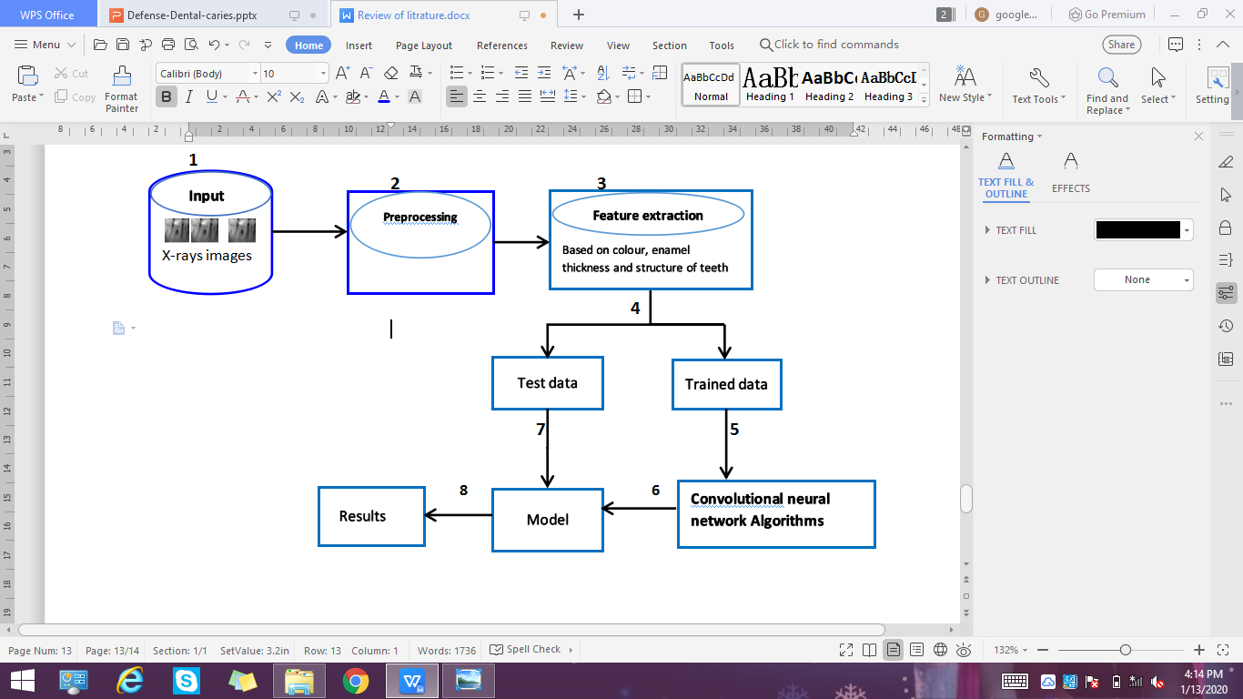
METHODOLOGY
Fayqa
fayqabio@gmail.com
9 of 15
Notes:
Step 1: input the data in form of x-rays images
Step 2: Pre-processing the data(changes Raw data into useful data)
Step 3: Feature extraction. based on colour, enamel thickness and structure of teeth
Step 4: Data-set division into train and test data.
Step 5: CNN algorithms for detection of images.
Step 6: Train the data to detect the caries from images (Model create)
Step 7: Run this model on test data.
Step 8: Comparison the results.
Step 9: Output.

Slide 28
METHODOLOGY
Step 1: Input the data in form of x-rays images
Step 2: Pre-processing the data
Step 3: Feature extraction. based on colour, enamel thickness and structure of teeth.
Step 4: Data-set division into train and test data.
Step 5: CNN algorithms for detection of images.
Step 6: Train the data to detect the caries from images (Model create)
Step 7: Run the model on test data.
Step 8: results.
Fayqa
fayqabio@gmail.com
9 of 15
Notes:
Step 1: input the data in form of x-rays images
Step 2: Pre-processing the data(changes Raw data into useful data)
Step 3: Feature extraction. based on colour, enamel thickness and structure of teeth
Step 4: Data-set division into train and test data.
Step 5: CNN algorithms for detection of images.
Step 6: Train the data to detect the caries from images (Model create)
Step 7: Run this model on test data.
Step 8: Comparison the results.
Step 9: Output.

Slide 29
11. SIMULATION SETUP
Fayqa
fayqabio@gmail.com

Slide 30
SIMULATION SETUP
Tool , Work and special libraries:
Tool: Python Experimental setup: Colabs
Python's Libraries :
Numpy:
Pandas:
Keras:
TensorFlow:
Pillow:
Sklearns:
Matplotlib:
Fayqa
fayqabio@gmail.com
11 of 15
Notes:
Python's Libraries :
Numpy :adding support for large, multi-dimensional arrays and matrices ,a large collection of high-level mathematical functions to operate on these arrays.
Pandas: pandas is a software library, the Python programming language for data manipulation and analysis.
Keras: Keras is an Open Source Neural Network library written in Python
TenserFlow:free and open-source software library for dataflow, used for machine learning applications such as neural networks
Pillow: It adds support for opening, manipulating, and saving many different image file formats
Sk-learns: Scikit-learn is a free machine learning library for Python. supports other libraries like numpy etc.
Myplotlib: Matplotlib is a plotting library for the Python and numerical mathematics extension NumPy

Slide 31
15. FUTURE WORK
Fayqa
fayqabio@gmail.com

Slide 32
FUTURE WORK
Further Extentions:
Run same modle for other oral disordes broken teeth due to calcium like periontals, broken teeth due to calcium deficiency
Expand this reseach for animals.
Covnert it into mobile app so everyone can there teeth themselves.
Fayqa
fayqabio@gmail.com
15 of 15
Notes:
1- This research can be extended to other disorders
2- Expand this reseach for animals.
3- Covnert it into mobile app so everyone can there teeth themselves.

Slide 33

THANK YOU
Fayqa
fayqabio@gmail.com

